Slide 1
ICT Skills for Teachers
Saul Pila

Slide 2

Partners in Learning
Good education = fulfilling life at home and in the workplace
Framework for teachers and learners to acquire the skills they need to make the best use of that technology in teaching and learning

Slide 3

Partners in Learning

Slide 4
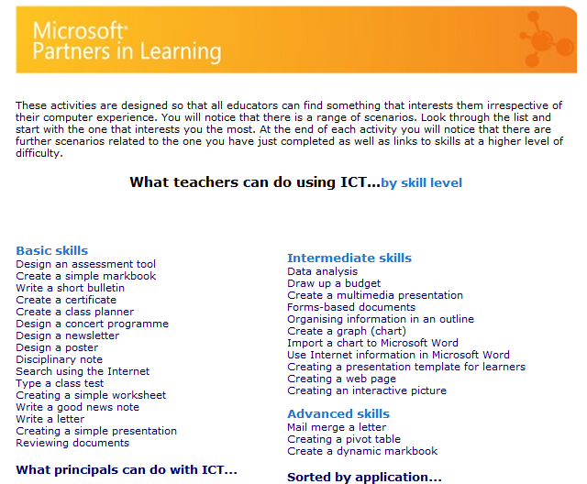
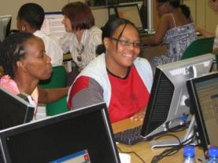
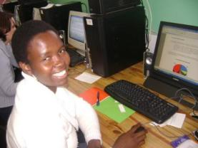
ICT Skills for Teachers: using office application in their roles as teachers

Slide 5
Training
Schedule
  3 days initial training
  Individual practice
  2 day follow-up (3 weeks later)
Aim:
  Support teachers to become an independent learner
    Ask 3 before me
      Tip sheets
      Help index
      A colleague

Slide 6
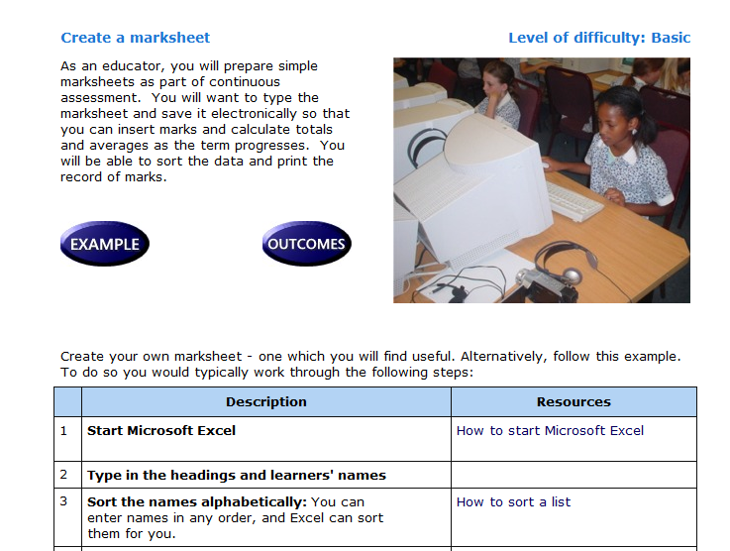
Just in time, adult based learning principles

Slide 7
Scenarios
ICT Skills for teachers
Three levels of skills
  Basic
  Intermediate
  Advanced
Let’s look at scenarios ...

Slide 8
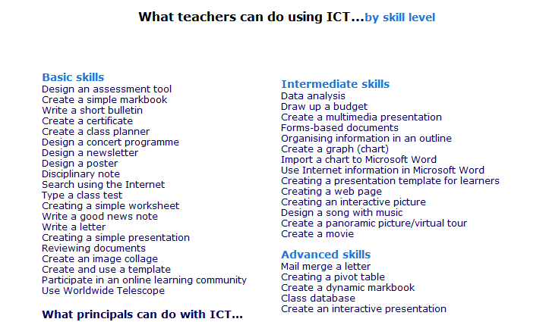
Scenarios

Slide 9

THANK YOU
www.partnersinlearning.co.za
© 2008 Microsoft Corporation. All rights reserved. Microsoft, Windows, Windows Vista and other product names are or may be registered trademarks and/or trademarks in the U.S. and/or other countries.
The information herein is for informational purposes only and represents the current view of Microsoft Corporation as of the date of this presentation. Because Microsoft must respond to changing market conditions, it should not be interpreted to be a commitment on the part of Microsoft, and Microsoft cannot guarantee the accuracy of any information provided after the date of this presentation.
MICROSOFT MAKES NO WARRANTIES, EXPRESS, IMPLIED OR STATUTORY, AS TO THE INFORMATION IN THIS PRESENTATION.

